Slide 1
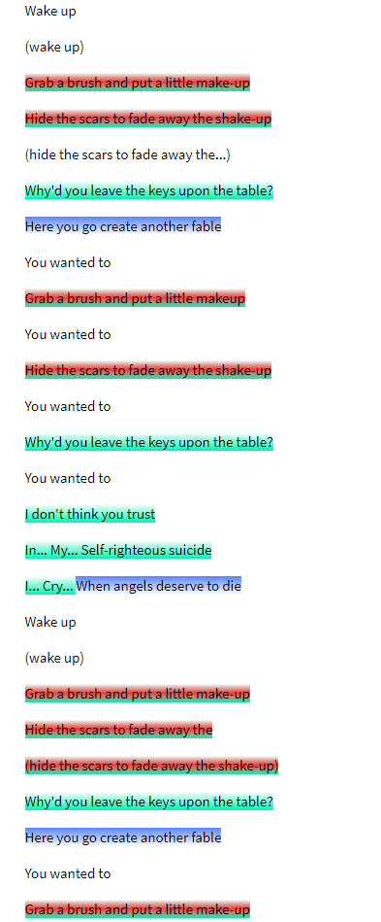
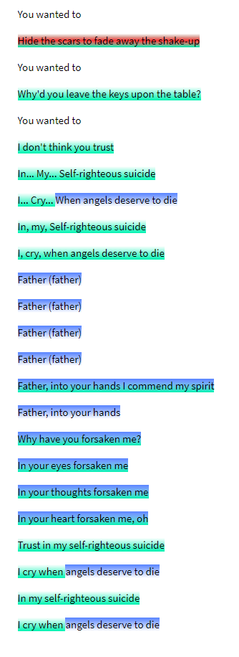
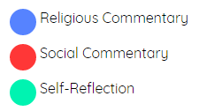
Initial Research and Findings
Single interpretation of the lyrics from “Chop Suey!” by System of a Down

Slide 2
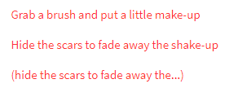
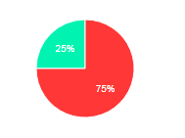
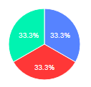

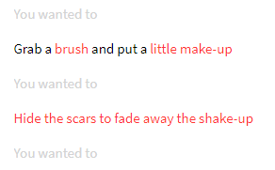
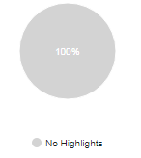
Analysis of our Prism
Certain areas were heavily voted as one category
Indicative of strong theme
Others show an even distribution
More subjective meaning
Multiple meanings?
Some areas not highlighted
Not due to lack of meaning; repetition

Slide 3
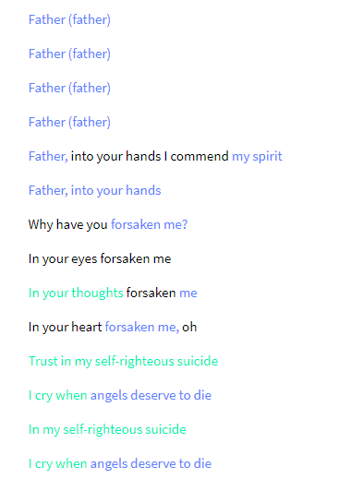
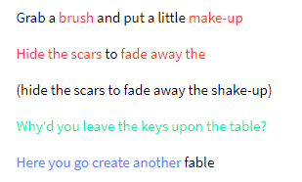
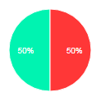
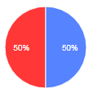
Analysis of our Prism
Viewing whole verses begins to paint a better picture of meaning
Flow of the song

Slide 4
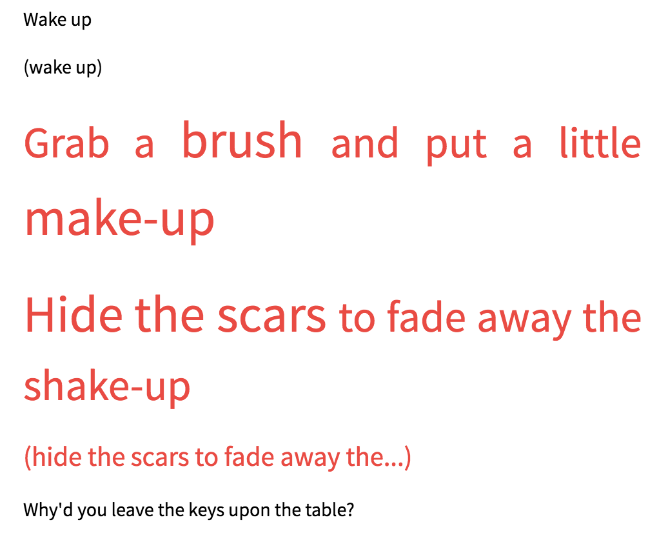
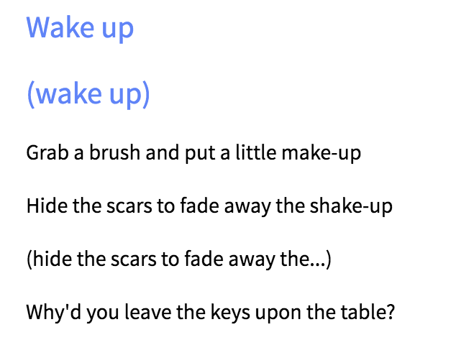
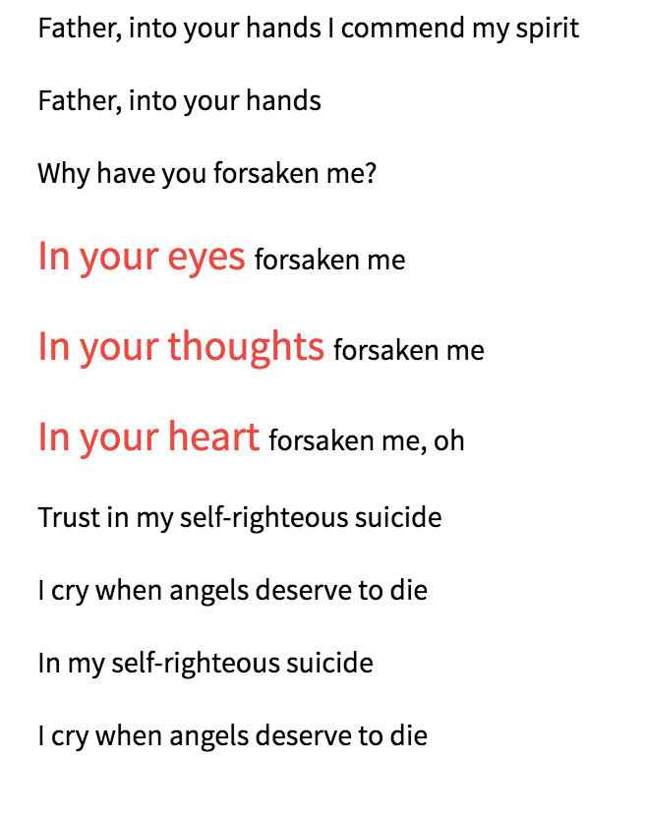
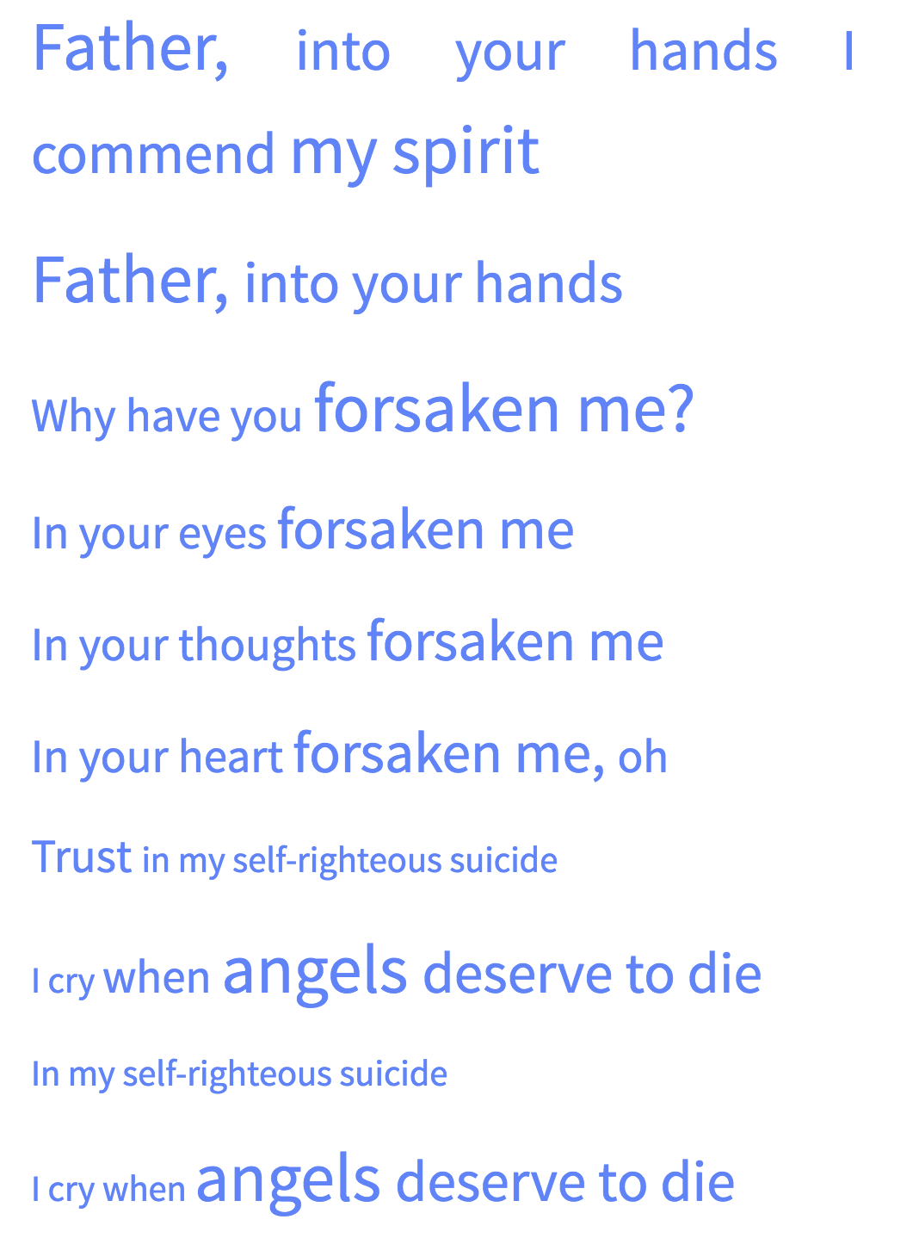
Analysis and Conclusions
Using font size visualization shows clear trends
Size corresponds to importance
Conclusions?
Social → Religious
Self Reflective

Slide 5
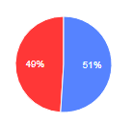
Issues in Analysis
Cannot generate percentage visualizations for more than one word at a time
Hard to accurately represent trends in large bodies of text
Colour of text does not show degree to which a certain facet “wins”
Can misrepresent meaning
Cannot add new facets

